Slide 1
2-5 Absolute Value Functions & Graphs
M11.D.2.1.2: Identify or graph functions, linear equations, or linear inequalities on a coordinate plane

Slide 2
Objectives
Graphing Absolute Value Functions

Slide 3
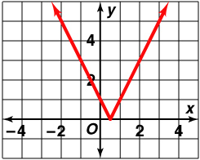
Vocabulary
A function of the form f(x) = |mx + b| + c, where
m ≠ 0, is an absolute value function.
The vertex of a function is the point where the function reaches a maximum or minimum.
Graphs of absolute values look like angles

Slide 4
Graphing an Absolute Value Funtion
Graph y = |2x – 1| by using a table of values.
Evaluate the equation for several values of x.
Make a table of values.
x –1.5 –1 –0.5 0 0.5 1 1.5 2 2.5
y 4 3 2 1 0 1 2 3 4
Graph the function.

Slide 5
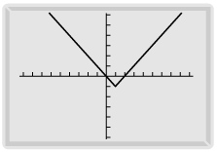
Using a Graphing Calculator
Graph y = |x – 1| – 1 on a graphing calculator.
Use the absolute value key. Graph the equation
Y₁ = abs(X – 1) – 1

Slide 6
Writing Two Linear Equations
Use the definition of absolute value to graph y = |3x + 6| – 2.
Step 1: Isolate the absolute value.
y = |3x + 6| – 2
y + 2 = |3x + 6|
Step 2: Use the definition of absolute value. Write one equation for 3x + 6 0 and a second equation for 3x + 6 < 0.
>
–
>
when 3x + 6 < 0
y + 2 = –(3x + 6)
y = –3x – 8
when 3x + 6 0
y + 2 = 3x + 6
y = 3x + 4
–

Slide 7
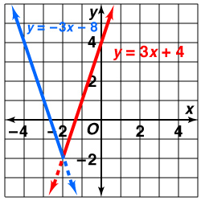
Continued
(continued)
Step 3: Graph each equation for the appropriate domain.
When 3x + 6 0, or x –2, y = 3x + 4.
When 3x + 6 < 0, or x < –2, y = –3x – 8.
>
>
–
–

Slide 8
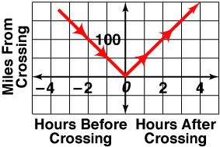
Real World Example
A train traveling on a straight track at 50 mi/h passes a certain crossing halfway through its journey each day. Sketch a graph of its trip based on its distance and time from the crossing.
The equation d = |50t| models the train’s distance from the crossing.

Slide 9
Homework
Pg 90 # 1,10, 19, 29

