Slide 1
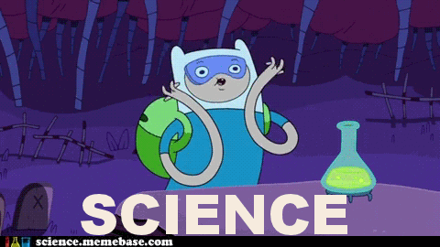

Steve the scientist
By Hannah Keiper

Slide 2
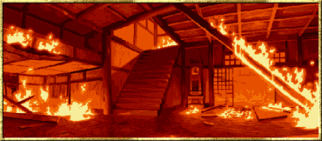


Steve the scientist
He blew up his laboratory
His theory worked
His theory failed

Slide 3

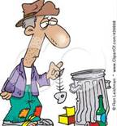
A few days later Steve the scientist was working with an explosive chemical. Steve the scientist was not careful enough with this chemical called sodium azide. The next thing he knew Steve the scientist’s house blew up.
He also blew up his neighbors house
He becomes homeless

Slide 4

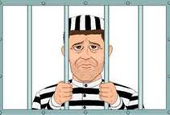
The sodium azide explosion was so big that the explosion also blew up Steve the scientist’s neighbor’s house. Steve the scientist’s neighbors weren’t home when the explosion happened. When they got home they were so angry that they started chasing after Steve the scientist.
He went to jail
His neighbors sued him

Slide 5

A few days later Steve the scientist was walking down the road when a cop car pulled up beside him. The cop asked Steve the scientist to come down to the station with him. When Steve the scientist went down to the station he received a paper. The paper said that Steve the scientist’s neighbors were suing him for burning their house down.

Slide 6
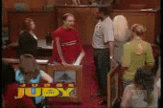
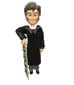
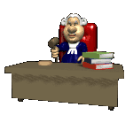
Steve the scientist went to jail for misuse of a chemical substance. He was also charged for catching his neighbor’s house on fire. Steve the scientist went to jail for the rest of his life and he died in jail and never had any visitors.

Slide 7
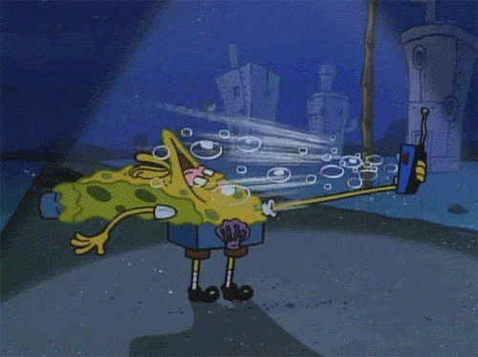
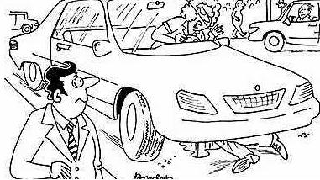

When Steve the scientists house blew
up he had nobody to turn to, all of his family choose to shun him because he was a failure. They yelled at him and told him never to talk to them again. So therefore Steve the scientist became homeless. Steve the scientist had nothing because he lost everything in the explosion.
He had to sit on the side of the road to get money
He got hit by a car

Slide 8

Steve the scientist had to live on the side of the road. Steve the scientist put a cup out for people to put money in. Everybody who walked by just ignored Steve the scientist and kept on walking.

Slide 9

Steve the scientist’s eyes were hurt during the explosion. Steve the scientist becomes blind and nobody knows. One day Steve the scientist was walking down the road and somebody was texting and driving. Steve the scientist got hit by that car and died.

Slide 10

One day a scientist by the name of Steve was trying to figure out how to clone humans. Steve the scientist had worked on this experiment for 2 years now. He was reaching his boiling point, and was ready to give up.
he became rich
He was so happy he went crazy

Slide 11
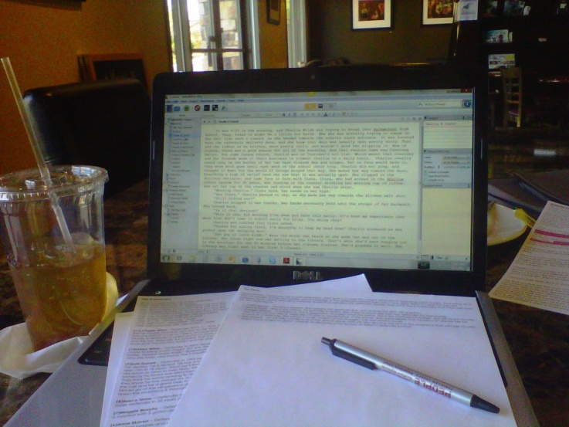
Steve the scientist shows the National Science Council and they approve his theory. Steve the scientist becomes rich and someone wants to write a book about him. Then Steve the scientist writes his own book about his theory.
He wrote a book on his success
Somebody robbed him

Slide 12






A month after Steve the scientist figured out that his theory worked he decided to write a book on his success. His book got published the first time. He sold over 1 million copies in less than a month.

Slide 13
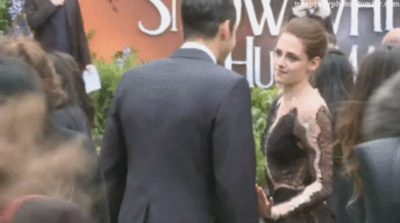
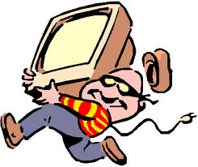
A year after Steve the scientist became rich he got invited to a red carpet. After the party when he got home his house was trashed. Steve the scientist called the police because he was robbed.

Slide 14
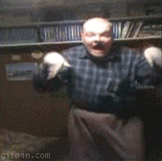
When Steve the scientist found out that his theory had worked he went crazy. He literally went crazy he started laughing like a mad person. He started pulling his hair out and he had to be put in a mental institution.
He became a serial killer
He commits suicide

Slide 15
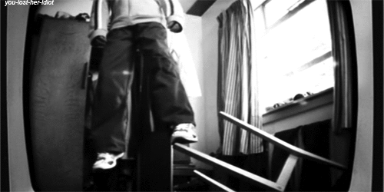
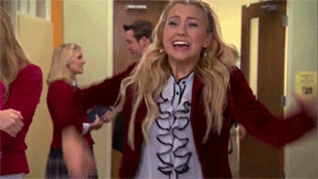
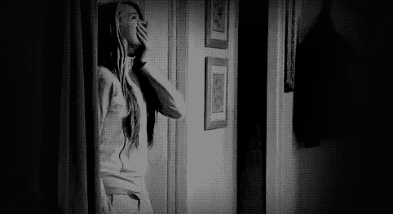
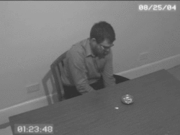
Steve the scientist was in the mental hospital for a few years. One day he decided that he was so bored and he committed suicide. His nurse found him and screamed until somebody came.

Slide 16
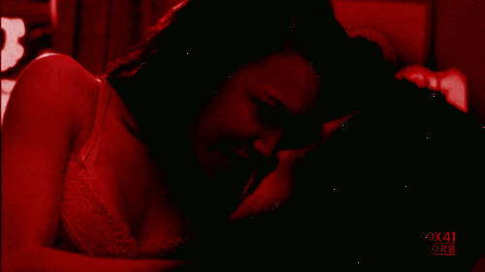
Steve the scientist became mentally ill. Steve the scientist started killing any random person in his sight. Steve the scientist became the most known serial killer in the world.

Slide 17
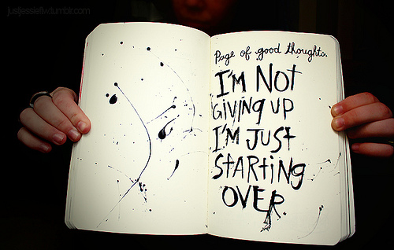
Steve the scientist’s theory failed again. He could not get it to work and he didn’t know how to. Steve the scientist was not going to give up just yet.
He tried over and over to fix his theory
He gave up all hope and moved to Timbuktu

Slide 18
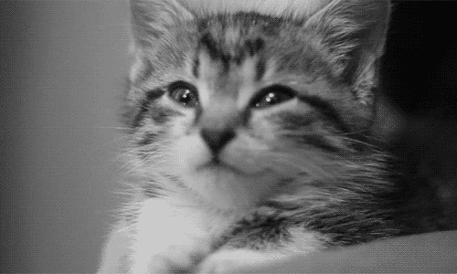
Steve the scientist tried over and over again to fix his little mistakes. Lately he had been staying up so late he was not getting any sleep. He went a week with no sleep, which was not easy at all. At this point his eyes would involuntary close and finally he could not keep them open. Steve the scientist slept for two day straight.
He died before he got his theory to work
Somebody else figured out his theory before he did

Slide 19
Steve the scientist was old now and was not going to give up on his theory until it worked. However it did not go as well as planned. Steve the scientist died at the age of 92 while still trying to figure out how to make his theory work.

Slide 20
Steve the scientist had no idea but he had some rivalry. A young man by the name of Carter Samuels had also been trying how to figure out how to make human clones. But before Steve the scientist could figure out how to make human cones, Carter Samuels did.

Slide 21
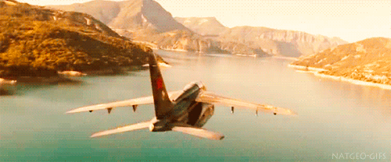
Steve the scientist gave up on all hope for him to figure out how to make human clones. He decided to move out to Timbuktu so he wouldn't be known as the biggest failure in life. He packed up all he had and got on his plane.
He lived in a cave and nobody ever saw him again
He auditioned for the show “survivor”

Slide 22
When Steve the scientist got to Timbuktu he moved into a cave and lived there. Nobody ever saw Steve the scientist ever again. Nobody ever spoke to or heard from Steve the scientist again either.

Slide 23
Steve the scientist lived in Timbuktu for about four years. He decided to go on the show “Survivor”. Steve the scientist ended up winning the show because he lived in Timbuktu for so many years and lived in the wild alone.

