Slide 1
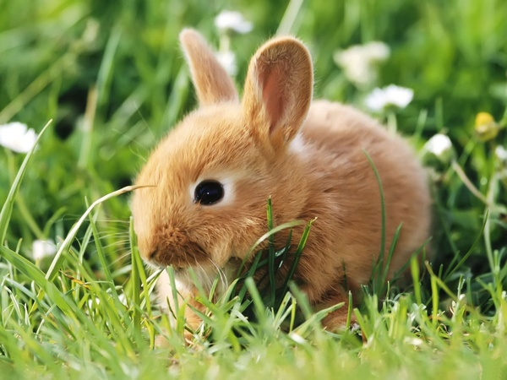
The Vicious Bunny Attack
By Kareena Dawn

Slide 2
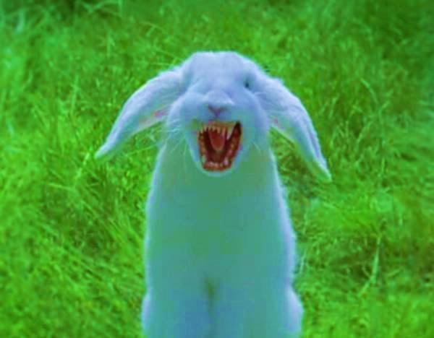
You call your mom to come pick you up
You try to sneak pass the bunny
Your walking in the woods when you see a vicious bunny
You run and scream like a little girl

Slide 3
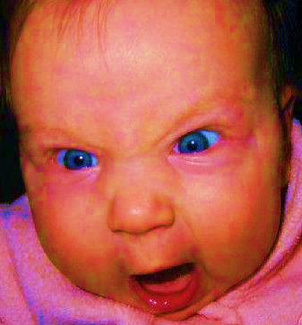
You run and scream like a girl
You end up at the police station. The police ask what wrong you tell them you have a vicious bunny chasing you. They burst with laughter.
You complain to the police
Press charges

Slide 4
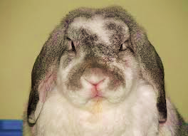
You end up pressing charges on the bunny. The police go out the get the bunny to bring him in for questioning.
the bunny realizes that it was wrong to scare you
the bunny gets mad

Slide 5
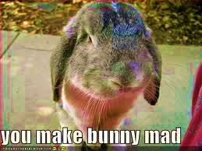
The bunny gets mad at you for pressing charges on him. So he decides to bite you leg off

Slide 6
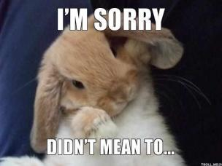
The bunny realizes that it was wrong to scare you so he backs off and leaves you alone

Slide 7
you complain to the police and they end up arresting him and putting him in jail
the bunny was put in jail
the bunny breaks out of jail

Slide 8
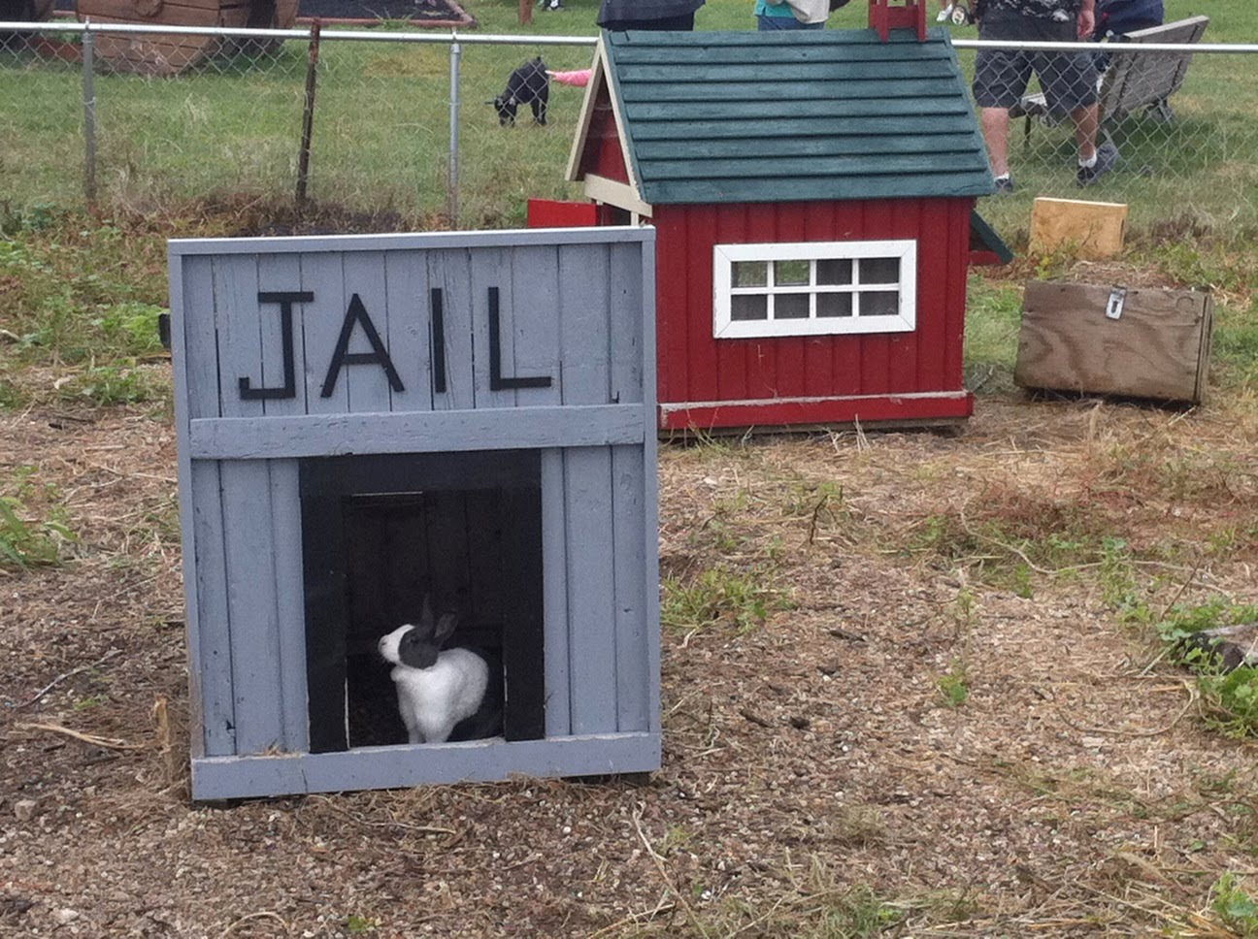
The police put the bunny in jail for 6 years

Slide 9
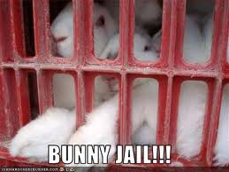
The bunny breaks out of jail he finds you and eats your leg off.

Slide 10
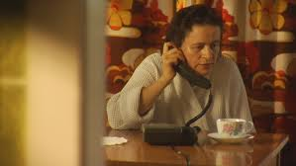
You call your mommy to come and pick. On her way to get you she accidently drives her car off a cliff.
You cry yourself to sleep
You jump off a cliff

Slide 11
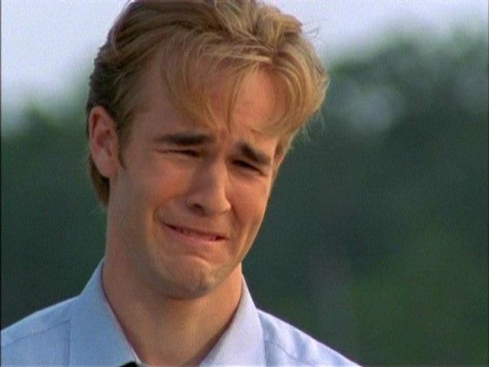
you cry yourself to sleep and the bunny tries to eat you.
You kick the bunny
You decide you have no reason to live

Slide 12
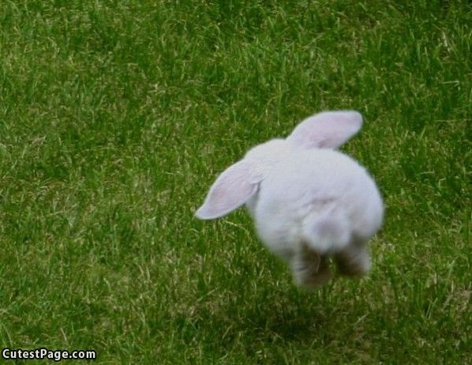
you throw the bunny off of you and the bunny hops away

Slide 13
you decide that you have no reason to live so you decide to let the bunny eat you.

Slide 14
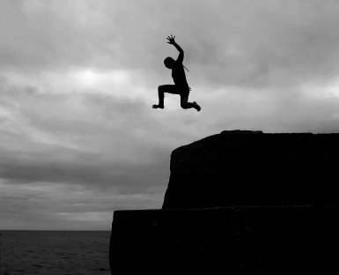
you jump off the cliff to try to save your mother
you and your mother are now living a very happy life
you get to the bottom and manage to stay alive

Slide 15
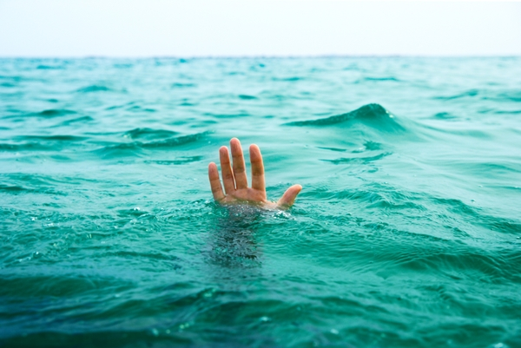
you get to the bottom and manage to stay alive you look up to see your mother turns out only the car went off the cliff

Slide 16
you and your mother are now living a very happy life in heaven without the bunny

Slide 17
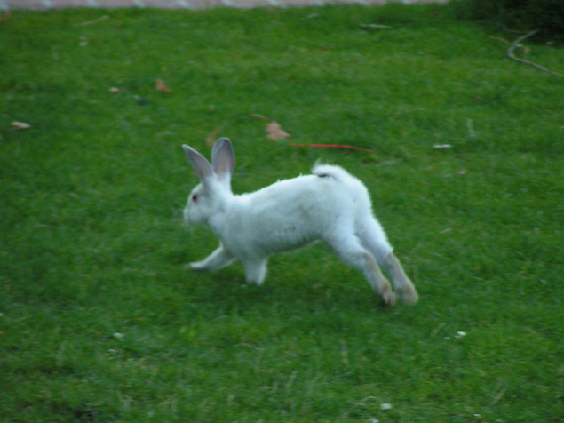
you try to sneak pass the bunny but you fail and the bunny starts chasing you
you climb a tree
you try to cross to the other side of the cliff

Slide 18
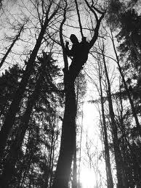
you climb a tree to try to get away from the bunny
You thought wrong
you didn't know that the bunny was a pro climber

Slide 19
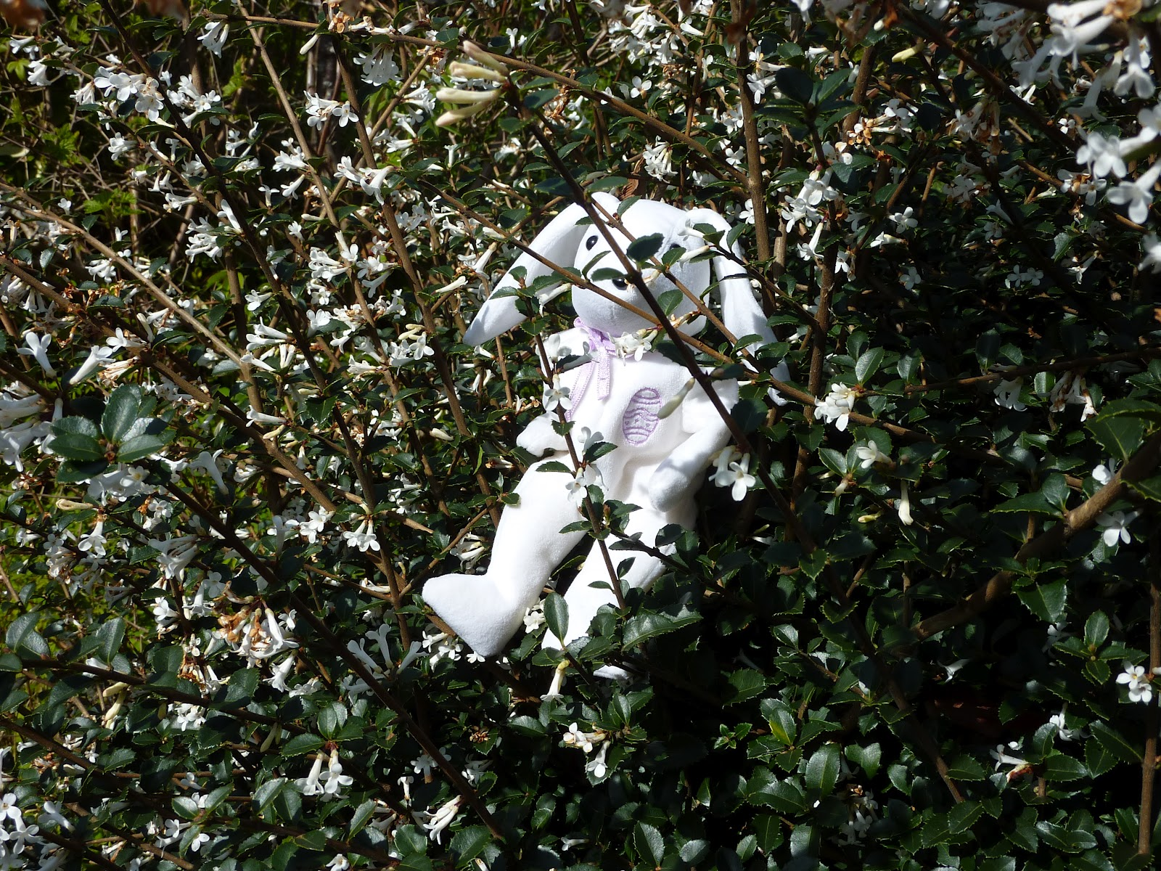
you didn't know that the bunny was a pro climber so the bunny gets you and eats you

Slide 20
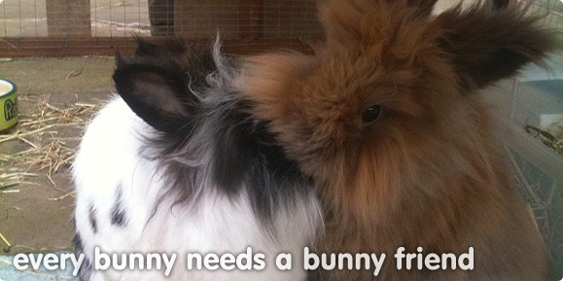
it turns out the bunny only wanted to be your friend

Slide 21
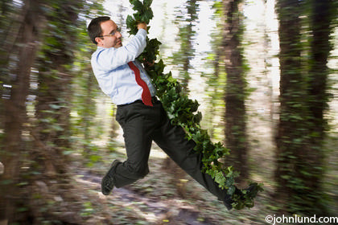
you try to cross to the other side of the cliff on a vine but the vine breaks.
you fall in the water
you fall onto a ledge

Slide 22
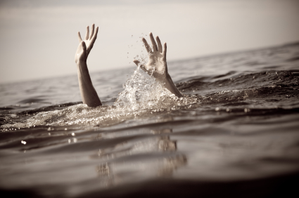
you fall in the water you fall in the water and drown because you cant swim

Slide 23
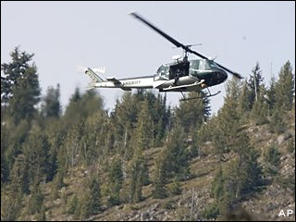
you fall onto a ledge and a plane comes and saves you and you move on with you life.

