Slide 1
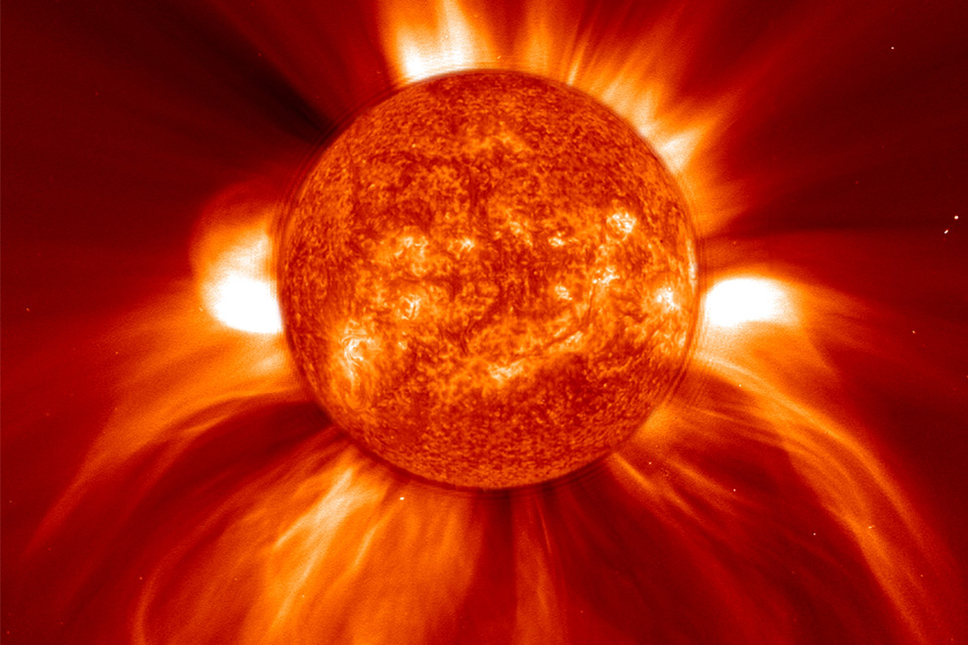
A Journey to SEE the sun
By: Peyton
Merkle
Next

Slide 2
You want to visit the sun...
You have always wanted to go up into space and see the sun from that point of view.
You don’t have anywhere close to get a rocket, nor can you afford one.
You buy a rocket.
A friend asks to go with you.

Slide 3
You don't have anywhere close to get a rocket, nor can you afford one.
You and your friends have a party.
You go on the computer…

Slide 4
You and your friends have a party.
Your parents walk in…
Everyone goes home, and you make food..

Slide 5
Your parents walk in on the party. Everyone stops dancing and immediately backs away slowly from your parents. They both go over to the radio, turn it up, and start dancing. You realize someone pulling out of the driveway in their car. You assume your parents were dropped off at your house, because they were drunk. You ask them, and they say, ‘Oh yeah!’
Home

Slide 6
You start to make some food. After you get the food set up to cook on the stove, you sit down and watch some television. Just a couple minutes later, you fall asleep. Your mother wakes you up and your father starts to carry you. You realize your outside, and the house is burning down.
Home

Slide 7
You go on the computer, write a story about it, and add pictures of rockets.
You show your friends…
Your parents find it…

Slide 8
Your parents find it and read it. The next day when you wake up and get breakfast, they talk to you about it. They ground you because they think you actually went on the journey.
Home

Slide 9
You show your friends at school your story. Some think it’s childish and that you made it up. Others think you made it up and it was cool. But most people think you actually went on the journey and think it is really cool. Because of your story, you’re the most popular kid in school.
Home

Slide 10
You buy your rocket.
You set up your rocket to go.
You ditch the idea, sell it, and call your girl/boy friend.

Slide 11
You ditch the idea, sell it, and call your girl/boy friend.
Both of you go to the movies.
You go out with her/him to dinner…

Slide 12
You go out with her/him to dinner. Fifteen minutes in, you get your food. There was awkward silence, so you start to talk . You begin to brag about buying a rocket. They get bored and annoying, and she/he leaves you. Then you go home and cry.
. . .
Home

Slide 13
Both of you go to the movies and you picked the movie. You picked a movie about rockets, and your partner says they love rockets. After the movie, they talk about how there is to go into outer space.
Home

Slide 14
You set your rocket up to go.
You go into outer space and don’t see the sun…
You go into outer space and you see the sun…

Slide 15
You go into space and didn't the sun. You were disappointed but then realize you’re running out of gas. You land on an unknown planet. These little creatures come up to you. You tell them how you find it to be really bright there. They give you sunglasses. You talk more to them, then become the ruler.
Home

Slide 16
You go into space, and see the sun. You want a little bit of a closer look, so you go a bit towards it. You want an even closer look, so you guide your rocket more towards it. You get too close, and the rays of it hits you’re rocket. The rocket melts and you’re exposed to no air, and happy that you decided to wear your space suit.
Home

Slide 17
A friend asks to go with you.
You and your friend decide to make a rocket.
You both go online and but the rocket.

Slide 18
You and your friend decide to make the rocket.
You and your friend are getting ready to take off…
It goes off without you…

Slide 19
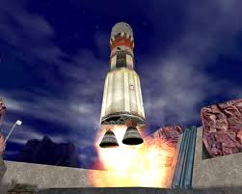
You and your friend are getting ready to take off the rocket. It starts making weird noises, and it is smoking. The rocket begins to take off, but instead it blows up in your face.
Home

Slide 20
It goes off without you. You don’t see where it goes. The next day, you hear on the news about a rocket flying into the Pacific Ocean. Also, it is said to be unsaid of whose rocket it is.
Home

Slide 21
You both go online and buy the rocket.
You bought the rocket…
They delivered it to you…

Slide 22
You bought the rocket. It takes a while to get there, so you figure they lost it in transporting it. After a while of still not getting it, you realize you probably won’t get it, and that it was a scam.
Home

Slide 23
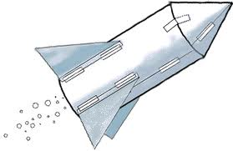
They delivered the rocket to you. But you realize you must put it together first. You ditch the idea of going into space and sell the rocket.
Home

